Slide 1
FIJI ITINERARY
For Honeymooners and Families

Slide 2
7-Days Fiji Itinerary for Honeymooners
Best Time to Visit Fiji
The peak Fiji travel season is July through September, where you'll find the best weather and dryest months. The wet season lasts from November through April, when you can expect a lot of humidity and short storms.
Best weather: July to September.
Festival highlights: The Fiji Day celebrations in October mark the country's independence with parades, music and dance; the Festival of Lights during Diwali is celebrated with fireworks, sweets and open houses; the Hibiscus Festival in August is one of Fiji's largest festivals, featuring beauty pageants, parades and live entertainment in Suva.

Slide 3
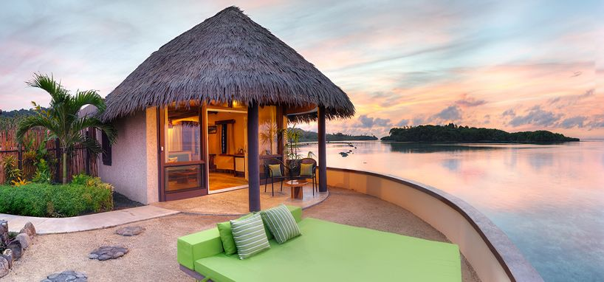
Few logistics to keep in mind
Language: Along with Fijan and Fijan Hindi, English is also an official language.
Location: Fiji is an archipelago in the South Pacific Ocean, located northeast of New Zealand and northwest of Tonga. It comprises more than 300 islands, with Viti Levu and Vanua Levu being the largest and most populous.
Currency: The Fijian Dollar (FJD).
Getting around: The most efficient way to explore Fiji's islands is by domestic flights and ferries. For getting around larger islands like Viti Levu, rental cars, taxis and buses are available. Many resorts also offer transfers and organized tours to popular attractions.

Slide 4
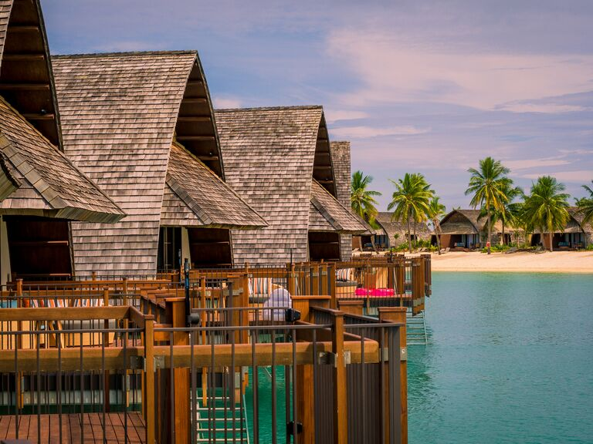
What to pack for a Fiji Honeymoon
The most important things on your packing checklist should include lightweight and breathable clothing suitable for the tropics and comfortable sandals. Essential sun protection items like reef-safe sunscreen, a wide-brimmed hat and UV-protective sunglasses are also key. You'll also want to pack a lightweight rain jacket in your honeymoon luggage, in case you run into the occasional shower.

Slide 5
Itinerary Details
Here’s a perfect 7-day honeymoon itinerary to Fiji, packed with beach visits, romantic activities, and cultural experiences. This itinerary balances relaxation, adventure, and local immersion while ensuring a maximum number of beach stops for an unforgettable tropical getaway.
Day 1: Arrival in Nadi
Travel Time: Arrival at Nadi International Airport.
  Transfer: Private car or resort shuttle transfer to your accommodation.
Accommodation: Tokoriki Island Resort (luxury adults-only resort in the Mamanuca Islands).
  Room Type: Beachfront Pool Bure (private pool, ocean views, perfect for couples).
Afternoon: Settle in and relax at Tokoriki Island's private beach.
  Activity: Stroll along the shore and watch the sunset.
Dinner: Romantic beachside dinner at the resort’s restaurant, serving Fijian and international cuisine.

Slide 6
Itinerary Details
Day 2: Beach and Snorkeling
Morning: After breakfast, head to Tokoriki's main beach for a morning swim or snorkeling session. The reef surrounding the island is full of colorful coral and tropical fish.
Activity: Half-day snorkeling trip to nearby reefs around the Mamanuca Islands.
Lunch: Beach picnic organized by the resort.
Afternoon: Return to the resort for a couples' spa treatment (Fijian coconut oil massage).
Dinner: Enjoy an intimate private candlelit dinner by the beach, under the stars.
Day 3: Day Trip to Castaway Island and Monuriki Island
Travel Time: Short boat ride to Castaway Island and Monuriki Island (where Cast Away was filmed).
Activity: Full day of beach hopping, snorkeling, and exploring the pristine waters around these islands.
  Monuriki Island: White sandy beaches and crystal-clear waters ideal for swimming and snorkeling.
Lunch: Picnic lunch on the beach, prepared by the resort.
Afternoon: Relax on the beach or enjoy more snorkeling.
Evening: Return to Tokoriki Island Resort for a romantic dinner.

Slide 7
Itinerary Details
Day 4: Private Beach Picnic and Adventure
Morning: Private beach picnic on one of the resort’s secluded beaches. Enjoy some quiet time together away from the crowds.
Activity: Explore the local reef through a couples’ kayaking experience.
Afternoon: Stand-up paddleboarding or relax by the resort pool.
Evening: Take a sunset cruise around the Mamanuca Islands. Sip champagne as the sun sets over the Pacific.
Day 5: Coral Coast and Natadola Beach
Travel Time: Boat transfer to the mainland followed by a drive to the Coral Coast.
Accommodation: Check-in at InterContinental Fiji Golf Resort & Spa on Natadola Beach, one of Fiji’s best beaches.
Morning Activity: Explore Natadola Beach, a stunning long stretch of white sand and turquoise water.
  Activity: Beach horseback riding along the shore.
Lunch: Enjoy a meal at Toba Bar & Grill, a beachfront restaurant at the InterContinental.
Afternoon: Relax at Natadola Bay or indulge in a couples' spa treatment at the resort.
Evening: Romantic dinner at Navo Restaurant, offering fine dining with ocean views.

Slide 8
Itinerary Details
Day 6: Sigatoka River and Eco Tour
Morning: Take a Sigatoka River safari (half-day trip). Learn about Fijian culture and explore villages along the river.
Lunch: Enjoy traditional Fijian cuisine in a local village.
Afternoon: Return to Natadola Beach for some more beach time and relaxation.
Evening: Romantic beachfront BBQ at the InterContinental, arranged just for the two of you.
Day 7: Departure
Morning: Final swim or beach walk at Natadola Beach.
Lunch: Light lunch at Sanasana Restaurant.
Travel Time: Check out and transfer to Nadi International Airport for your flight home.

Slide 9
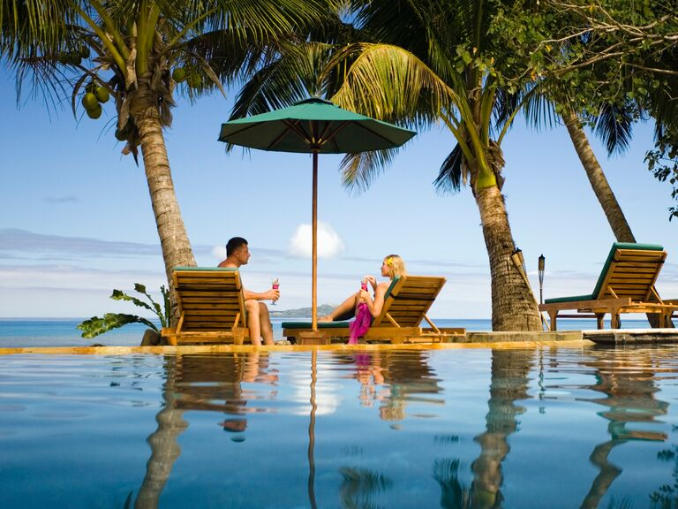
Special Information
Travel Style: Private, luxurious, and romantic, perfect for honeymooners. Expect secluded experiences, beach picnics, and personalized services at high-end resorts.
Activities: Snorkeling, kayaking, horseback riding, sunset cruises, cultural village tours.
Meals: Breakfast included at the resorts, with opportunities for private beach dinners and fine dining at luxury restaurants.
Key Beaches Visited:
Tokoriki Island Beach (private and secluded).
Castaway Island Beach (pristine with excellent snorkeling).
Monuriki Island (famous for Cast Away movie).
Natadola Beach (one of the most beautiful in Fiji).

Slide 10
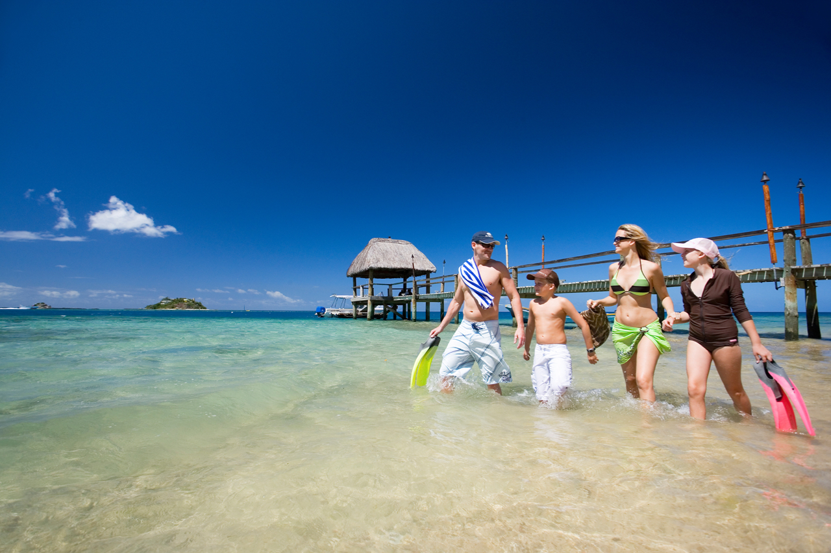
14-Days Fiji Itinerary for Families
Here’s a 14-day family itinerary for Fiji, designed to offer a balance of fun beach activities, cultural experiences, adventure, and relaxation. This itinerary includes a variety of island stops, family-friendly accommodations, and unique activities that will entertain both kids and adults.
Day 1: Arrival in Nadi
Travel Time: Arrival at Nadi International Airport.
  Transfer: Private car or resort shuttle transfer to your accommodation.
Accommodation: Radisson Blu Resort or Sheraton Fiji Resort (family-friendly resorts on Denarau Island).
  Room Type: Family Suite or Interconnecting Rooms.
Meal: Dinner at Blu Bar & Grill, offering family-friendly menus.
Evening: Relax at the resort, walk along the beach, and settle in.

Slide 11
Itinerary Details
Day 2: Explore Denarau Island
Morning: Relax at the resort’s private beach and pool. Kids can enjoy the Blu Banana Kids Club with supervised activities.
Lunch: Poolside meal at Chantara Thai Restaurant or Neptunes.
Afternoon: Take a short catamaran cruise around the waters of Denarau or visit the Port Denarau Marina for shopping and family-friendly cafes.
Evening: Enjoy a casual family dinner at the Flying Fish Restaurant with ocean views.
Day 3: Island Hopping to the Mamanuca Islands
Travel Time: 1-hour ferry to the Mamanuca Islands.
Accommodation: Plantation Island Resort (family-friendly with excellent facilities for kids).
  Room Type: Family Beachfront Bure.
Activity: Explore Plantation Island’s beach with snorkeling, kayaking, and family beach games.
Meal: Buffet dinner at Ol’ Copra Shed.
Day 4: Snorkeling and Beach Fun
Morning: Take a family snorkeling trip to the outer reefs of the Mamanucas.
Afternoon: Kids can join the Coconut Kids Club, while parents relax at the beach or spa.
Evening: Family dinner at the resort’s beachfront BBQ restaurant.

Slide 12
Itinerary Details
Day 5: Full-Day Excursion to Castaway Island
Travel Time: 30-minute boat ride.
Activity: Spend the day on Castaway Island.
  Highlights: Beach picnic, snorkeling, exploring coral reefs, and relaxing on white-sand beaches.
Evening: Return to Plantation Island Resort for a quiet evening.
Day 6: Beach Adventure on Malolo Island
Morning: Ferry to Malolo Island.
  Activity: Explore the island’s beaches with family-friendly water sports.
Lunch: Enjoy fresh seafood at the Treetop Restaurant.
Afternoon: Relax or take part in a family nature hike to discover the island’s lush tropical forests.
Evening: Return to Plantation Island Resort for dinner.
Day 7: Cultural Immersion and Village Tour
Morning: Fijian village visit. Participate in a kava ceremony and learn about Fijian customs and lifestyle.
Lunch: Local meal in the village or return to the resort for lunch.
Afternoon: Enjoy some quiet beach time or take a glass-bottom boat tour to explore underwater life without getting wet.
Evening: Fijian Lovo Feast (underground oven cooking) at the resort, followed by a fire dance performance.

Slide 13
Itinerary Details
Day 8: Day Trip to Monuriki Island
Travel Time: 1-hour boat ride to Monuriki Island (where Cast Away was filmed).
Activity: Spend the day exploring the island, swimming, and snorkeling in the crystal-clear waters.
Evening: Return to the resort for dinner and an early night.
Day 9: Beach Fun on Mana Island
Travel Time: Ferry transfer to Mana Island.
Accommodation: Mana Island Resort (another family-friendly resort with great amenities).
  Room Type: Family Beach Bure.
Activity: Explore the island’s beaches with plenty of time for snorkeling, swimming, and kayaking.
Meal: Dinner at South Beach Restaurant, known for fresh seafood and stunning views.
Day 10: Relax and Water Sports
Morning: Spend the day enjoying the resort’s private beach and take part in family-friendly water sports like paddleboarding and windsurfing.
Lunch: Enjoy lunch at Mamanuca Restaurant.
Afternoon: Kids can enjoy the kids' club, while parents relax with a couples’ massage at the resort spa.
Evening: Dinner at the resort, followed by a family movie night at the resort’s open-air cinema.

Slide 14
Itinerary Details
Day 11: Coral Coast Adventure
Travel Time: Return to the mainland and head to the Coral Coast.
Accommodation: The Warwick Fiji (known for family facilities and stunning beach views).
  Room Type: Ocean View Family Room.
Activity: Explore the Warwick's private beach, go snorkeling, or take a walk along the coral coastline.
Evening: Family buffet dinner at the resort’s restaurant.
Day 12: Sigatoka Sand Dunes and Kula Eco Park
Morning: Visit the Sigatoka Sand Dunes for a family-friendly hike and learn about the area’s archaeological significance.
Lunch: Local Fijian meal in Sigatoka town.
Afternoon: Visit Kula Eco Park, where kids can interact with native Fijian wildlife.
Evening: Return to the resort for dinner and relax by the beach.

Slide 15
Itinerary Details
Day 13: Natadola Beach and Water Sports
Morning: Spend the day at Natadola Beach, one of the most beautiful beaches in Fiji.
  Activity: Beach horseback riding and swimming in the crystal-clear waters.
Lunch: Enjoy a beachfront picnic.
Afternoon: Relax on the beach or participate in water sports like boogie boarding or surfing.
Evening: Return to The Warwick Fiji for a final family dinner.
Day 14: Final Day in Nadi
Morning: Return to Nadi and spend your last day relaxing at the resort or doing some final souvenir shopping.
Lunch: Light lunch at a local café in Nadi.
Afternoon: Relax at the resort pool or take a walk along the beach.
Evening: Family farewell dinner at the resort, reminiscing about the beautiful trip.
Day 15: Departure
Travel Time: Transfer to Nadi International Airport for your flight home.

Slide 16
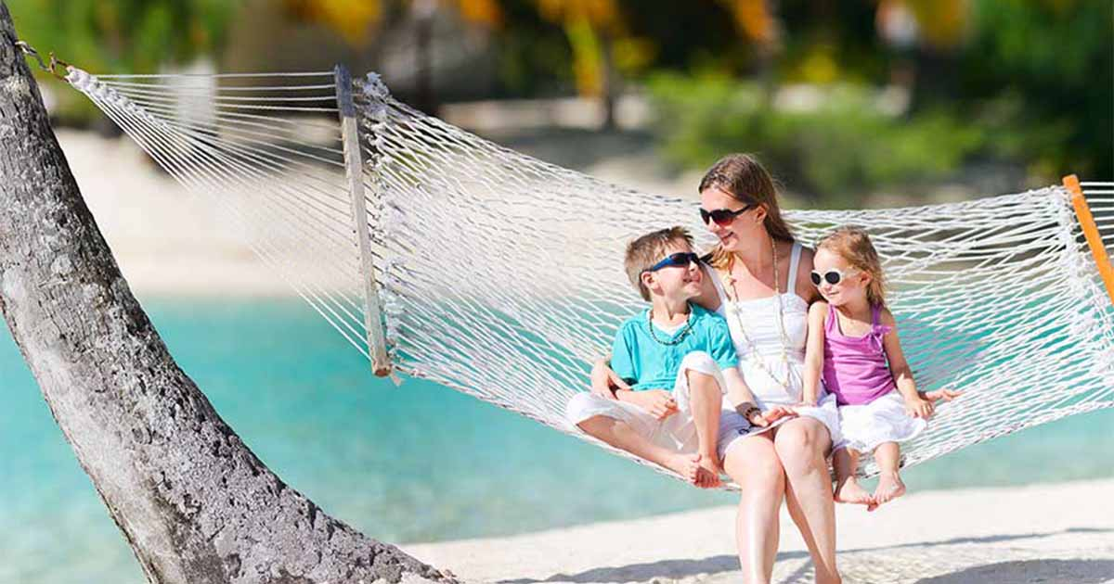
Special Information
Travel Style: Family-oriented, with a balance of beach fun, nature exploration, and cultural immersion.
Activities: Snorkeling, hiking, village visits, water sports, family movie nights, eco-park visits.
Activities: Snorkeling, hiking, village visits, water sports, family movie nights, eco-park visits.
Key Beaches Visited:
Denarau Island Beach
Plantation Island Beach
Castaway Island Beach
Monuriki Island Beach
Malolo Island Beach
Mana Island Beach
Natadola Beach

