Slide 1
MALAYSIA ITINERARY
For Honeymooners and Families

Slide 2
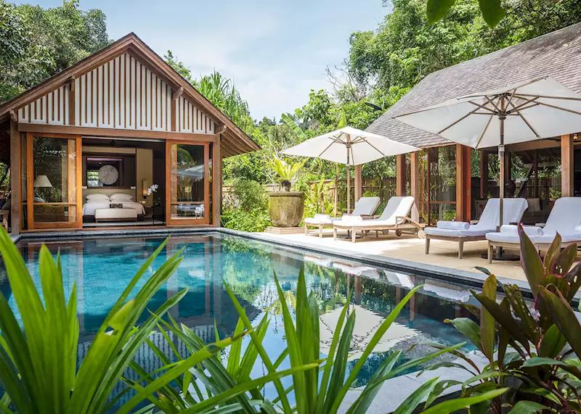
14-days Malaysia itinerary for honeymooners
BEST MONTHS AND TOURIST SEASON TO VISIT MALAYSIA
November, February, and March are the best seasons to enjoy the pleasant weather in Malaysia. These are also the time when you see minimal crowds. There are two peak tourist seasons in Malaysia. One is during the beginning of December which makes the holiday season for Christmas, New Year, and Chinese New Year. Hari Raya Puasa, celebrating the end of Ramadan, is also a peak time for tourists.
Here is an 8-day honeymoon itinerary for Malaysia, covering Kuala Lumpur, Langkawi, and Penang, combining luxury, beach experiences, and cultural exploration.

Slide 3
Itinerary details
Day 1: Arrival in Kuala Lumpur
Travel Time: Arrival at Kuala Lumpur International Airport (KLIA).
  Transfer: Private car transfer to your hotel.
Accommodation: Mandarin Oriental Kuala Lumpur (luxury hotel near the city center).
  Room Type: City View Suite.
Meal: Have a romantic dinner at Marini’s on 57, with breathtaking views of the Petronas Twin Towers.
Evening Activity: Stroll around KLCC Park and watch the light show by the fountains.
Day 2: Kuala Lumpur Exploration
Morning: Visit the iconic Petronas Twin Towers and explore the observation deck.
Lunch: Enjoy a fusion meal at Fuego in the Troika Sky Dining complex.
Afternoon: Explore Batu Caves and the Royal Selangor Pewter Factory to experience Malaysia’s cultural side and shop some handicraft souveniers.
Evening: Relax at the hotel’s spa and have dinner at Cantaloupe for modern European cuisine with an Asian twist.

Slide 4
Itinerary details
Day 3: Kuala Lumpur to Langkawi
Travel Time: 1-hour flight from Kuala Lumpur to Langkawi.
  Transfer: Private transfer to the resort.
Accommodation: The Ritz-Carlton Langkawi (luxury beachfront resort).
  Room Type: Ocean View Villa with a private pool.
Lunch: Lunch by the pool at the resort’s Beach Grill restaurant.
Afternoon Activity: Relax on Pantai Cenang Beach or indulge in water sports like jet skiing or parasailing.
Other options: Visit to Makam Mahsuri, Atma Alam Art Village and Eagle Square in Kedah.
Evening: Romantic sunset cruise with champagne and dinner, watching the sun dip below the horizon.
Day 4: Island Hopping and Beaches
Morning: Go on an island-hopping tour of Langkawi, including visits to Pulau Dayang Bunting (Lake of the Pregnant Maiden) and Pulau Beras Basah for swimming and snorkeling.
Afternoon: Return to Pantai Tengah Beach for a relaxing swim or continue snorkeling.
Evening: Return to the resort for a private beach dinner organized by the hotel.

Slide 5
Itinerary details
Day 5: Langkawi Sky Bridge and Waterfall Adventure
Morning: Ride the Langkawi SkyCab up to Mount Mat Cincang and walk across the Langkawi Sky Bridge for spectacular views of the island.
Lunch: Enjoy a beachfront meal at The Cliff restaurant, with ocean views.
Afternoon: Visit the stunning Telaga Tujuh Waterfalls (Seven Wells), where you can swim in the natural pools.
Nature Lovers can do the Jungle Trek and Rainforest Evening walk
Evening: Return to the resort for a romantic couple’s spa treatment, followed by a dinner at Kayuputi, offering fine seafood cuisine.
Day 6: Langkawi to Penang
Travel Time: 30-minute domestic flight to Penang.
  Transfer: Private car transfer to the hotel.
Accommodation: Shangri-La’s Rasa Sayang Resort & Spa, Penang (luxury beachfront resort).
  Room Type: Deluxe Seaview Room.
Lunch: Have a beachside meal at Feringgi Grill.
Afternoon Activity: Stroll along Batu Ferringhi Beach, one of Penang’s most famous beaches, and relax by the sea.
Evening: Enjoy Penang’s street food with a visit to Gurney Drive or dine at Suffolk House, a colonial-era mansion with a fine dining experience.

Slide 6
Itinerary details
Day 7: Penang Cultural Exploration
Morning: Take a guided tour of George Town, a UNESCO World Heritage site. Visit Kek Lok Si Temple, the Clan Jetties, and the famous Penang Street Art.
Lunch: Savor local dishes like Char Kway Teow and Penang Laksa at China House Café.
Afternoon: Relax on the soft sands of Monkey Beach or go on a short trek to Penang National Park.
Other Options: Botanic Gardens & Tropical Spice Garden Tour.
Evening: Have a romantic dinner at David Brown’s Restaurant on Penang Hill, offering panoramic views of the island.
Day 8: Departure
Morning: Relax with a final swim in Batu Ferringhi Beach or visit Penang Hill for a morning walk before checking out.
Transfer: Private car transfer to Penang International Airport for your onward flight to Kuala Lumpur and home.

Slide 7

Special information
Travel Style: This itinerary is designed for a luxury honeymoon with a focus on beach relaxation, cultural exploration, and romantic dining experiences.
Meals: A mix of beachfront dining, fine dining in cityscapes, and local delicacies.
Activities: Island hopping, snorkeling, cultural tours, romantic beach dinners, and exploring UNESCO heritage sites.
Key Beaches and Resorts:
1. Pantai Cenang Beach, Langkawi
2. Pulau Beras Basah Beach, Langkawi
3. Pantai Tengah Beach, Langkawi
4. Batu Ferringhi Beach, Penang
5. Monkey Beach, Penang

Slide 8
15-Days Malaysia Itinerary for Families
Here’s a 15-day family itinerary to Malaysia, including Kuala Lumpur, Cameron Highlands, Penang, Langkawi, Kota Kinabalu, Kinabalu National Park, and Sandakan, with kid-friendly activities, travel time, accommodation, and meal suggestions.
Day 1: Arrival in Kuala Lumpur
Travel Time: Arrival at Kuala Lumpur International Airport (KLIA).
Accommodation: Traders Hotel Kuala Lumpur, near KLCC Park (great for kids).
Room Type: Family Room.
Meals: Dinner at Atmosphere 360 revolving restaurant with city views.
Activities: Evening stroll to Petronas Towers and KLCC Park for kids' playground.

Slide 9

Itinerary Details
Day 2: Kuala Lumpur City Exploration
Morning: Visit Batu Caves—kids will enjoy climbing the
colorful steps.
Lunch: Try Jalan Alor for kid-friendly local food.
Afternoon: Explore the KL Bird Park and Butterfly Park.
Evening: Dinner at Suria KLCC Food Court.
Kids' Activity: Visit Aquaria KLCC, a family-friendly aquarium.
Day 3: Kuala Lumpur to Cameron Highlands
Travel Time: 3.5-hour drive to Cameron Highlands.
Accommodation: The Lakehouse Cameron Highlands.
Room Type: Family Suite.
Meals: Enjoy an English-style tea at the hotel.
Activities: Visit Strawberry Farms and pick fresh strawberries, or explore the Butterfly Garden.
Evening: Dinner at the hotel's restaurant with local fresh produce.

Slide 10
Itinerary Details
Day 4: Cameron Highlands Exploration
Morning: Visit Boh Tea Plantation, and enjoy scenic tea views.
Lunch: Light lunch at Cameron Organic Produce Steamboat.
Afternoon: Explore the Mossy Forest with a nature guide.
Evening: Relax with a family dinner at the hotel or explore the local night market.
Day 5: Cameron Highlands to Penang
Travel Time: 3.5-hour drive to Penang.
Accommodation: Shangri-La's Rasa Sayang Resort in Batu Ferringhi.
Room Type: Family Room.
Meals: Lunch at Feringgi Grill.
Activities: Relax on Batu Ferringhi Beach.
Evening: Visit Penang Hill for sunset views and family-friendly dinner.

Slide 11
Itinerary Details
Day 6: Penang Exploration
Morning: Take a George Town cultural tour, visiting Chew Jetty and Kek Lok Si Temple.
Lunch: Street food at Gurney Drive Hawker Centre.
Afternoon: Visit Penang Interactive Museum and Penang Butterfly Farm for kids.
Evening: Family dinner at Suffolk House.
Day 7: Penang Island Hopping
Morning: Beach day at Monkey Beach and Penang National Park.
Afternoon: Continue enjoying the beach and hiking.
Evening: Dinner at Feringgi Garden Restaurant.

Slide 12
Itinerary Details
Day 8: Penang to Langkawi
Travel Time: 30-minute flight to Langkawi.
Accommodation: The Datai Langkawi.
Room Type: Family Villa with Ocean View.
Meals: Lunch at The Pavilion (Thai cuisine).
Activities: Relax at Pantai Cenang Beach, known for watersports.
Evening: Dinner at The Beach Club with sunset views.
Day 9: Langkawi Island Hopping
Morning: Island hopping to Pulau Dayang Bunting (Lake of the Pregnant Maiden).
Lunch: Picnic on the beach during the island tour.
Afternoon: Continue island hopping, with swimming and family beach time.
Evening: Dinner at The Gulai House (Malay cuisine).

Slide 13
Itinerary Details
Day 10: Langkawi Adventure
Morning: Ride the Langkawi Cable Car and walk the Sky Bridge.
Lunch: At the SkyCab Café.
Afternoon: Visit Telaga Tujuh Waterfalls for family fun.
Evening: Dinner at Kayuputi for fine dining with a beach view.
Day 11: Langkawi to Kota Kinabalu
Travel Time: 2.5-hour flight to Kota Kinabalu, Borneo.
Accommodation: Shangri-La’s Tanjung Aru Resort.
Room Type: Family Suite.
Meals: Lunch at Café TATU.
Activities: Relax on Tanjung Aru Beach, with playgrounds for kids.
Evening: Family dinner at Sunset Bar with sunset views.

Slide 14
Itinerary Details
Day 12: Kinabalu National Park
Morning: 2-hour drive to Kinabalu National Park.
Activities: Family nature walk and visit to the Botanical Garden.
Afternoon: Enjoy the Canopy Walkway and relax at the Poring Hot Springs.
Evening: Dinner back at the resort.
Day 13: Kota Kinabalu to Sandakan
Travel Time: 1-hour flight to Sandakan.
Accommodation: Sepilok Nature Resort.
Room Type: Family Chalet.
Meals: Lunch at the resort.
Activities: Visit the Sepilok Orangutan Rehabilitation Centre, where kids can learn about wildlife conservation.
Evening: Dinner at the resort restaurant.

Slide 15
Itinerary Details
Day 14: Sandakan Wildlife Experience
Morning: Visit the Bornean Sun Bear Conservation Centre.
Afternoon: Take a Kinabatangan River cruise to spot exotic wildlife like proboscis monkeys and pygmy elephants.
Evening: Return to the resort for a family dinner.
Day 15: Departure from Sandakan
Travel Time: Flight to Kuala Lumpur and onward flight home.
Key Highlights:
Nature & Wildlife: Cameron Highlands, Kinabalu National Park, Sepilok Orangutan Centre.
Beaches: Batu Ferringhi, Pantai Cenang, Monkey Beach, Pulau Dayang Bunting.
Family Activities: Aquaria KLCC, Penang Butterfly Farm, Langkawi Sky Bridge, Tanjung Aru Beach playground.

