Slide 1
PHILIPPINES ITINERARY
For Honeymooners and Families

Slide 2
Best Time To Visit the Phillipines
The Philippines has two main seasons: the rainy and the hot season. As their names suggest, you can expect heavy monsoon rains during the rainy season, and extremely warm and humid weather during the hot season. There are pros and cons to visiting the country in either of the two, but most people obviously prefer the hot season as it increases your chance of having clear skies and being able to enjoy the beaches.
The rainy season lasts between June and October. During those months you should expect heavy rainfall on a daily basis, and the chance of seeing the sun come out is quite slim. The biggest upside to visiting the country during this time is of course the prices. Most hotels and airlines offer discounted rates, which means you can cut you budget by at least 30% if you don’t mind risking a bit of rain. Fewer tourists at this time also mean the top sights will be less busy.
The hot season covers the rest of the year, with its peak being between February and May. While these months provide the perfect beach weather, it also means many locations become much more crowded and prices go up significantly. For tourists who are looking for a sweet spot between peak and off season, we recommend considering the shoulder season. All in all, the absolute best time to visit the Philippines is between November and January when the rain has already stopped but the temperatures haven’t risen too high yet.

Slide 3
9-Days Philippines Itinerary for Honeymooners
Day 1: Arrival in Manila
Travel Time: Arrive at Ninoy Aquino International Airport, Manila.
Accommodation: The Peninsula Manila.
Meals:
  Breakfast: Hotel buffet.
  Lunch: Filipino cuisine at Manam.
  Dinner: Romantic dining at The Champagne Room.
Activities:
  Visit Intramuros for historical sites like Fort Santiago.
  Evening walk along Roxas Boulevard at Manila Bay for sunset views.

Slide 4
Itinerary Details
Day 2: Travel to Boracay
Travel Time: 1-hour flight from Manila to Caticlan + 20-minute ferry to Boracay.
Accommodation: Shangri-La’s Boracay Resort & Spa (private beachfront villa).
Meals:
  Breakfast: At The Peninsula Manila.
  Lunch: Casual dining at D’Mall Boracay.
  Dinner: Beachfront dinner at Sirena Seafood Restaurant.
Activities:
  Relax at White Beach.
  Paraw sunset cruise for a romantic evening.

Slide 5
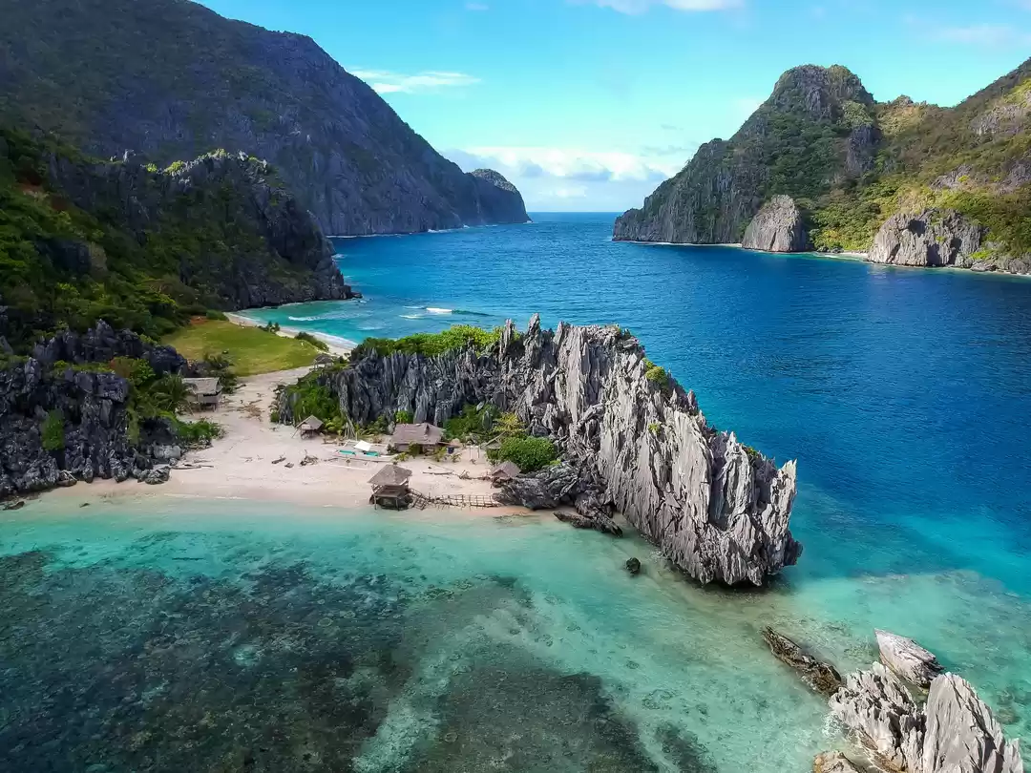
Itinerary Details
Day 3: Boracay Island Hopping
Accommodation: Shangri-La’s Boracay Resort & Spa.
Meals:
  Breakfast: At the resort.
  Dinner: Dinner at Dos Mestizos (Spanish-Filipino fusion).
Activities:
  Visit Puka Beach, Crocodile Island, and Crystal Cove.
  Snorkeling and swimming around Boracay’s best spots.

Slide 6
Itinerary Details
Day 4: Travel to Bohol
Travel Time: 1-hour flight from Boracay to Tagbilaran, Bohol.
Accommodation: South Palms Resort Panglao.
Meals:
  Breakfast: At Shangri-La Boracay.
  Lunch: Organic dining at Bohol Bee Farm.
  Dinner: Beachfront dining at the resort.
Activities:
  Visit the Chocolate Hills.
  Explore the Tarsier Sanctuary.
  Evening relaxation at the resort’s private beach.

Slide 7
Itinerary Details
Day 5: Bohol Exploration
Accommodation: South Palms Resort Panglao.
Meals:
  Breakfast: At the resort.
  Lunch: Loboc River Cruise.
  Dinner: At the resort.
Activities:
  Morning visit to Hinagdanan Cave.
  Afternoon at Alona Beach for snorkeling and relaxation.

Slide 8
Itinerary Details
Day 6: Travel to Palawan (Puerto Princesa)
Travel Time: 1-hour flight from Bohol to Puerto Princesa, Palawan.
Accommodation: Sheridan Beach Resort & Spa, Sabang.
Meals:
  Breakfast: At the resort in Bohol.
  Lunch: KaLui Restaurant in Puerto Princesa.
  Dinner: At the resort, beachfront dining.
Activities:
  Explore the Puerto Princesa Underground River.
  Relax on Sabang Beach for a peaceful afternoon.

Slide 9
Itinerary Details
Day 7: Travel to El Nido
Travel Time: 5-hour scenic drive from Puerto Princesa to El Nido.
Accommodation: El Nido Resorts - Pangulasian Island (luxury beachfront villa).
Meals:
  Breakfast: At Sheridan Beach Resort.
  Lunch: At Hama Street, El Nido.
  Dinner: Private beachfront dining at Pangulasian Island Resort.
Activities:
  Relax on the private beach at Pangulasian Island.
  Sunset cruise around Bacuit Bay.

Slide 10

Itinerary Details
Day 8: El Nido Island Hopping
Accommodation: El Nido Resorts - Pangulasian Island.
Meals:
  Breakfast: At the resort.
  Dinner: Romantic dinner at Cadlao Resort and Restaurant.
Activities:
  Visit Big Lagoon, Secret Beach, Small Lagoon, and Shimizu Island.
  Snorkel, kayak, and explore the serene coves of El Nido.

Slide 11
Itinerary Details
Day 9: Departure from El Nido to Manila
Travel Time: Fly from El Nido to Manila (1 hour).
Activities: Last-minute relaxation on the beach or resort before departure.
Beaches Covered:
White Beach (Boracay)
Puka Beach (Boracay)
Sabang Beach (Palawan)
Private Beach (Pangulasian Island)
Big Lagoon and Small Lagoon (El Nido)
Shimizu Island Beach (El Nido)

Slide 12
17-Days Philippines Itinerary for Families
Day 1: Arrival in Cebu
Travel Time: Arrive at Mactan-Cebu International Airport.
Accommodation: Shangri-La’s Mactan Resort & Spa (family suite).
Meals:
  Breakfast: At the resort.
  Lunch: Local cuisine at Zubuchon (famous for Cebu lechon).
  Dinner: Fine dining at Abaca Baking Company.
Activities:
  Visit Magellan’s Cross and Fort San Pedro for a historical introduction.
  Relax on the beach and enjoy the resort's kid-friendly pool.

Slide 13
Itinerary Details
Day 2: Island Hopping in Cebu
Accommodation: Shangri-La’s Mactan Resort & Spa.
Meals:
  Breakfast: At the resort.
  Dinner: Casual dining at The Pyramid.
Activities:
  Go on a family-friendly island-hopping tour to Hilutungan Island and Nalusuan Island for snorkeling.
  Afternoon beach time at Mactan Island.

Slide 14
Itinerary Details
Day 3: Cebu to Bohol
Travel Time: 2-hour ferry from Cebu to Tagbilaran, Bohol.
Accommodation: Henann Resort Alona Beach (family room).
Meals:
  Breakfast: At the resort.
  Lunch: Fresh seafood at Bohol Bee Farm.
  Dinner: At the resort’s beachside restaurant.
Activities:
  Visit the famous Chocolate Hills.
  Explore the Tarsier Sanctuary.
  Relax at Alona Beach.

Slide 15
Itinerary Details
Day 4: Dolphin Watching and Island Hopping in Bohol
Accommodation: Henann Resort Alona Beach.
Meals:
  Breakfast: At the resort.
  Dinner: At the resort’s beachside restaurant.
Activities:
  Dolphin Watching: Early morning boat trip to spot spinner dolphins near Pamilacan Island.
  Visit Balicasag Island for snorkeling and fish feeding.
  Afternoon at Virgin Island, a small white-sand paradise.

Slide 16
Itinerary Details
Day 5: Bohol River and Adventure Day
Accommodation: Henann Resort Alona Beach.
Meals:
  Breakfast: At the resort.
  Lunch: Loboc River Cruise (family-friendly river tour with buffet).
  Dinner: Local dining at Giuseppe Pizzeria & Sicilian Roast.
Activities:
  Enjoy a Loboc River Cruise.
  Visit the Butterfly Sanctuary.
  Optional ATV adventure near the Chocolate Hills (great for kids).

Slide 17
Itinerary Details
Day 6: Bohol to Dumaguete
Travel Time: 2-hour ferry from Tagbilaran to Dumaguete.
Accommodation: Atmosphere Resorts & Spa (family villa).
Meals:
  Breakfast: At the resort.
  Lunch: Sans Rival Bistro (try their famous silvanas).
  Dinner: Fine dining at the resort.
Activities:
  Afternoon relaxation at Atmosphere’s private beach.
  Evening exploration of Rizal Boulevard.

Slide 18

Itinerary Details
Day 7: Apo Island Snorkeling
Accommodation: Atmosphere Resorts & Spa.
Meals:
  Breakfast: At the resort.
  Dinner: Casual dining at Lab-as Seafood Restaurant.
Activities:
  Snorkeling at Apo Island with the chance to see turtles (great for kids).
  Evening relaxation at the resort’s family-friendly spa.

Slide 19
Itinerary Details
Day 8: Dumaguete to Boracay
Travel Time: Fly from Dumaguete to Caticlan (1 hour).
Accommodation: Discovery Shores Boracay (family suite).
Meals:
  Breakfast: At the resort.
  Lunch: Local dining at D’Talipapa market.
  Dinner: Beachfront dining at Dos Mestizos.
Activities:
  Relax on White Beach.
  Enjoy family-friendly water sports like banana boat rides.

Slide 20
Itinerary Details
Day 9: Boracay Adventure
Accommodation: Discovery Shores Boracay.
Meals:
  Breakfast: At the resort.
  Lunch: At Spicebird (flame-grilled piri-piri chicken).
  Dinner: Family dinner at Lemoni Café.
Activities:
  Go on an island-hopping tour to Puka Beach and Crocodile Island.
  Evening stroll along D’Mall for souvenirs.

Slide 21
Itinerary Details
Day 10: Boracay to El Nido
Travel Time: Fly from Caticlan to El Nido (1.5 hours).
Accommodation: El Nido Resorts - Lagen Island (family beach villa).
Meals:
  Breakfast: At Discovery Shores.
  Lunch: At Art Café El Nido.
  Dinner: Buffet at the resort.
Activities:
  Relax at the resort’s private beach.
  Enjoy sunset views over Bacuit Bay.

Slide 22
Itinerary Details
Day 11: El Nido Island Hopping
Accommodation: El Nido Resorts - Lagen Island.
Meals:
  Breakfast: At the resort.
  Dinner: At the resort’s restaurant.
Activities:
  Go on an island-hopping tour to Big Lagoon, Secret Beach, and 7 Commandos Beach.
  Kids can enjoy snorkeling and kayaking at Small Lagoon.

Slide 23
Itinerary Details
Day 12: El Nido Exploration
Accommodation: El Nido Resorts - Lagen Island.
Meals:
  Breakfast: At the resort.
  Lunch: Local dining at Squidos.
  Dinner: Beachfront BBQ at the resort.
Activities:
  Visit Nacpan Beach for a day of swimming and relaxation.
  Optional hiking adventure to Taraw Cliff.

Slide 24
Itinerary Details
Day 13: El Nido to Coron
Travel Time: 3-hour ferry ride from El Nido to Coron.
Accommodation: Two Seasons Coron Island Resort & Spa (family suite).
Meals:
  Breakfast: At the resort.
  Lunch: Local dining at Lolo Nonoy’s.
  Dinner: At Two Seasons’ Sulu Restaurant.
Activities:
  Relax at Banul Beach and Kayangan Lake (perfect for swimming and kayaking).
  Enjoy a Coron island-hopping tour.

Slide 25
Itinerary Details
Day 14: Coron Island Tour
Accommodation: Two Seasons Coron Island Resort & Spa.
Meals:
  Breakfast: At the resort.
  Dinner: Casual dining at Kawayanan Grill.
Activities:
  Visit Twin Lagoon, Skeleton Wreck, and Barracuda Lake.
  Kids can enjoy a fun-filled day of snorkeling and swimming.

Slide 26
Itinerary Details
Day 15: Coron to Puerto Princesa
Travel Time: Fly from Coron to Puerto Princesa (1 hour).
Accommodation: Daluyon Beach and Mountain Resort.
Meals:
  Breakfast: At Two Seasons Resort.
  Lunch: At Kalui Restaurant in Puerto Princesa.
  Dinner: Buffet dinner at the resort.
Activities:
  Visit the Puerto Princesa Underground River (family-friendly tour).
  Relax on Sabang Beach.

Slide 27
Itinerary Details
Day 16: Puerto Princesa to San Vicente
Travel Time: 3-hour drive to San Vicente.
Accommodation: Club Agutaya (family room).
Meals:
  Breakfast: At Daluyon Resort.
  Lunch: Local dining at Café Sabang.
  Dinner: At Club Agutaya.
Activities:
  Explore Long Beach in San Vicente.
  Family beach day with fun activities like swimming and beach games.

Slide 28
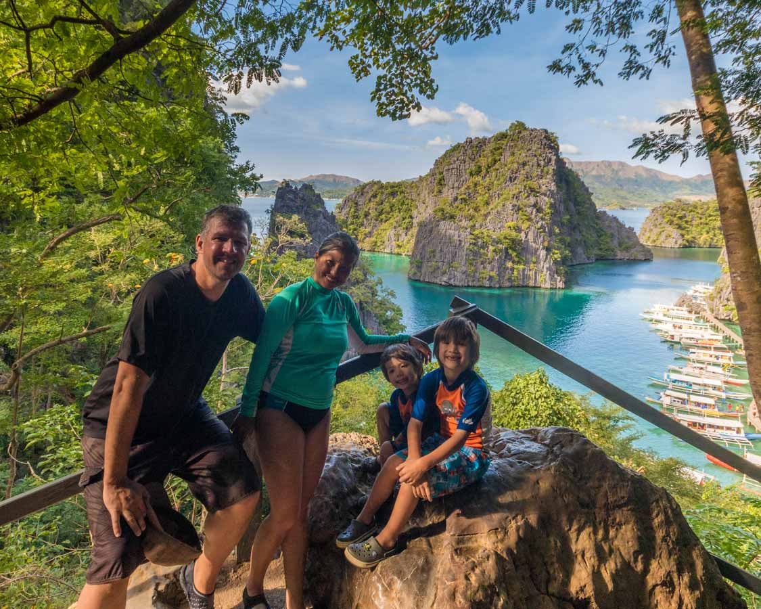
Itinerary Details
Day 17: Departure from Puerto Princesa
Travel Time: Fly from Puerto Princesa to Manila for international departure.
Activities: Last-minute beach relaxation or souvenir shopping before your flight.

