Slide 1
THAILAND ITINERARY
For Honeymooners and Families

Slide 2
Best Time to Visit Thailand
Thailand has a few different microclimates but overall the best time to visit Thailand for a honeymoon is from late November to April. It’s the dry season in Bangkok, northern Thailand, and the west coast beach areas of Phuket and the surrounding southern Thailand islands in the Andaman Sea.
The rainy season is from May to October. However, the worst months are September to October during the heaviest rains, so it is recommended to avoid these months.
The east coast beaches around Koh Samui in the Gulf of Thailand have a different climate pattern to the rest of the country and are usually fine from January to August. While many couples travel the country during the summer months from May to August, expect humidity and some bouts of heavy rain showers and thunderstorms.

Slide 3
10-Days Thailand Itenerary for Honeymooners
Day 1: Arrival in Bangkok
Travel Time: Arrive at Suvarnabhumi Airport in Bangkok.
Accommodation: Mandarin Oriental Bangkok, a luxurious riverside hotel.
Meals:
  Lunch: Thai street food in Chinatown (Yaowarat).
  Dinner: Riverside dinner at The Deck by the River, with views of Wat Arun.
Activities:
  Stroll along the vibrant Chao Phraya River.
  Visit the Grand Palace and Wat Pho (home of the reclining Buddha).
Enjoy a couple’s spa treatment at the hotel’s award-winning spa.

Slide 4
Itinerary Details
Day 2: Bangkok Exploration
Accommodation: Mandarin Oriental Bangkok.
Meals:
  Breakfast: In-house buffet at the hotel.
  Lunch: Thai cuisine at Baan Khanitha.
  Dinner: Rooftop dining at Vertigo & Moon Bar with a panoramic view of the city.
Activities:
  Explore the famous Chatuchak Weekend Market (if it’s a weekend).
  Take a romantic boat ride along the Chao Phraya River to explore Asiatique Night Market.
Enjoy a romantic river cruise or a sunset dinner cruise.

Slide 5
Itinerary Details
Day 3: Northern Thailand - Chiang Mai
Travel Time: 1.5-hour flight from Bangkok to Chiang Mai.
Accommodation: 137 Pillars House, a colonial-style luxury boutique hotel.
Meals:
  Lunch: At Dash! Restaurant and Bar (local Northern Thai cuisine).
  Dinner: Riverside dining at The Good View.
Activities:
  Visit the ancient Wat Phra That Doi Suthep for stunning hilltop views.
  Stroll around the Old City and explore Chiang Mai’s famous temples.
Experience a traditional Lanna-style dinner with live performances.

Slide 6
Itinerary Details
Day 4: Adventure in Chiang Mai
Accommodation: 137 Pillars House.
Meals:
  Breakfast: At the hotel.
  Lunch: At The Riverside (a riverside café with a view).
  Dinner: Traditional Khao Soi at Khao Soi Nimman.
Activities:
  Visit an ethical elephant sanctuary, such as Elephant Nature Park for a full day with the elephants.
  Visit the Chiang Mai Night Bazaar for shopping.
Enjoy a couple’s cooking class to learn how to make Northern Thai dishes.

Slide 7
Itinerary Details
Day 5: East Coast - Koh Samui
Travel Time: 1.5-hour flight from Chiang Mai to Koh Samui.
Accommodation: Six Senses Samui, a secluded luxury resort.
Meals:
  Lunch: At Green Bird, known for fresh seafood.
  Dinner: Beachfront dining at The Dining Room in your resort.
Activities:
  Relax on Chaweng Beach.
  Visit the Big Buddha and Wat Plai Laem temples.
Enjoy a sunset cocktail at Woobar with views of the coast.

Slide 8

Itinerary Details
Day 6: Koh Samui Beach Day
Accommodation: Six Senses Samui.
Meals:
  Breakfast: At the resort.
  Lunch: Beachside BBQ at The Jungle Club.
  Dinner: Romantic dining at Zazen Restaurant with candlelit tables by the beach.
Activities:
  Beach hopping: Explore Lamai Beach and Silver Beach for a quiet, romantic day.
  Optional snorkeling or kayaking trip around Ang Thong National Marine Park.
Book a couple’s massage at the Six Senses spa.

Slide 9
Itinerary Details
Day 7: West Coast - Phuket
Travel Time: 1-hour flight from Koh Samui to Phuket.
Accommodation: The Shore at Katathani, a luxury resort on Kata Noi Beach.
Meals:
  Lunch: Local seafood at Kan Eang@Pier.
  Dinner: Private beach dining at the resort.
Activities:
  Visit the famous Phang Nga Bay (James Bond Island).
  Spend the afternoon at Patong Beach and explore the vibrant nightlife.
Book a private sunset sail for a romantic evening at sea.

Slide 10
Itinerary Details
Day 8: Phuket - Island Hopping
Accommodation: The Shore at Katathani.
Meals:
  Breakfast: At the resort.
  Lunch: On board during the island-hopping tour.
  Dinner: Fine dining at Mom Tri’s Kitchen overlooking the ocean.
Activities:
  Full-day island hopping to Phi Phi Islands for beach time and snorkeling.
  Relax at Maya Bay (depending on access) and swim in the turquoise waters.
Capture stunning photos and enjoy a private beach picnic

Slide 11
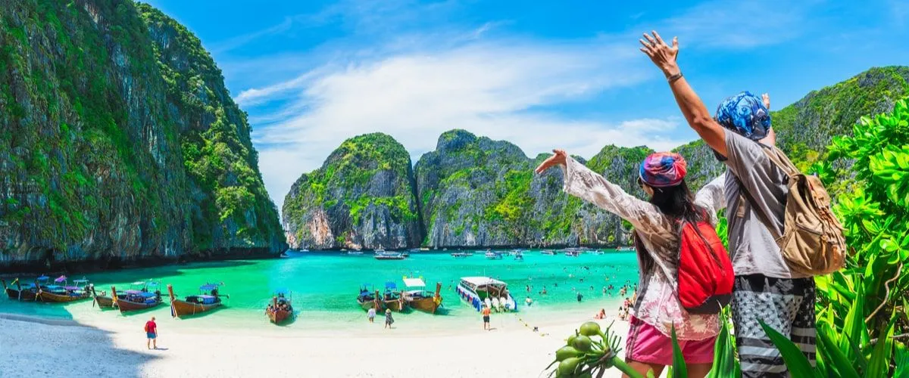
Itinerary Details
Day 9: Krabi (Optional Add-On)
Travel Time: 2-hour drive to Krabi or take a boat transfer.
Accommodation: Rayavadee Resort, nestled
between beaches and cliffs.
Meals:
  Lunch: Beachside at The Grotto.
  Dinner: Private dining on the beach at the resort.
Activities:
  Visit the stunning Railay Beach and Phra Nang Cave Beach.
  Explore hidden lagoons and caves by kayak.
Take part in a sunset yoga session with a view of the cliffs.

Slide 12
Itinerary Details
Day 10: Departure from Phuket
Travel Time: Return to Phuket International Airport for your flight home.
Meals: Farewell breakfast at your resort.
Enjoy your last morning on the beach before departure.
Highlights:
Beaches: Chaweng, Silver Beach, Lamai (Koh Samui), Kata Noi, Patong (Phuket), Maya Bay (Phi Phi Islands), Railay Beach (Krabi).
Luxury Resorts: Mandarin Oriental (Bangkok), 137 Pillars (Chiang Mai), Six Senses Samui, The Shore at Katathani (Phuket), Rayavadee Resort (Krabi).
Romantic Experiences: Private beach picnics, sunset cruises, spa treatments, and island-hopping tours.

